Slide 1
Project Management and Scheduling

Slide 2
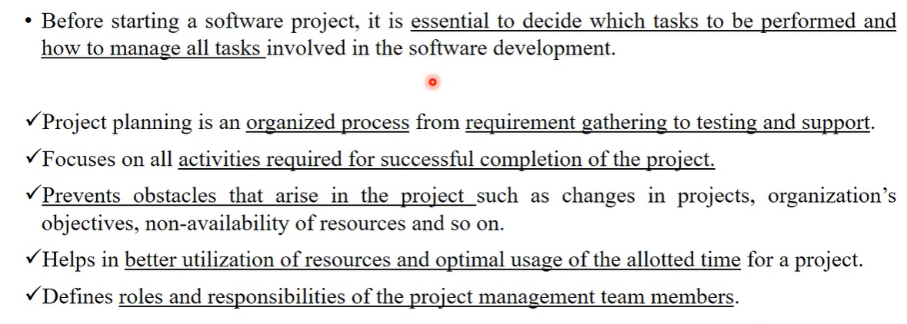
Project Planning

Slide 3
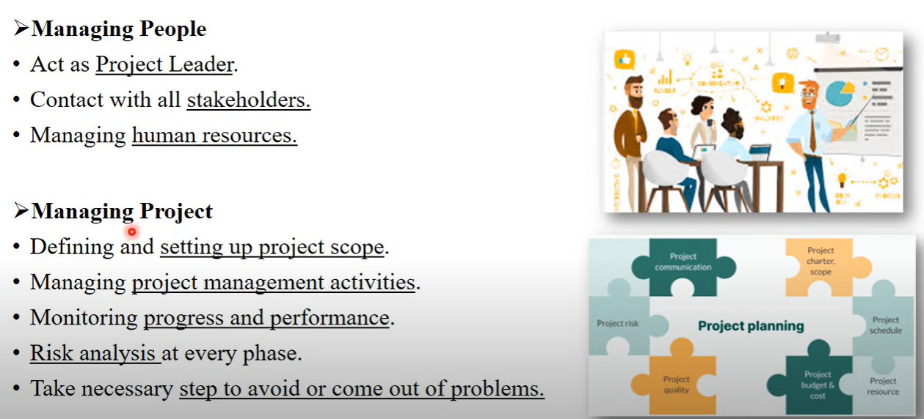
Software Project Manager

Slide 4
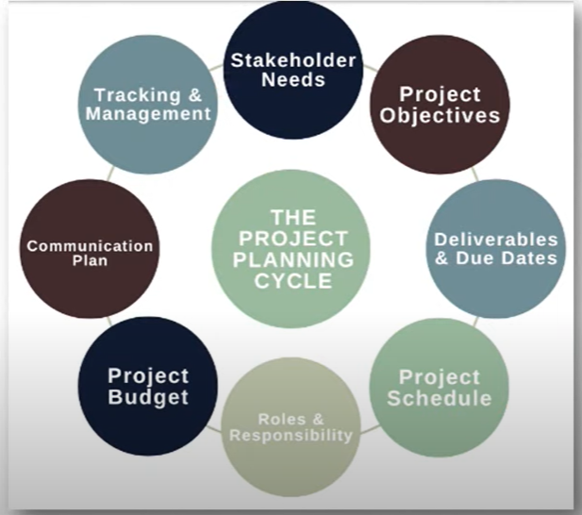
Project Planning Process

Slide 5
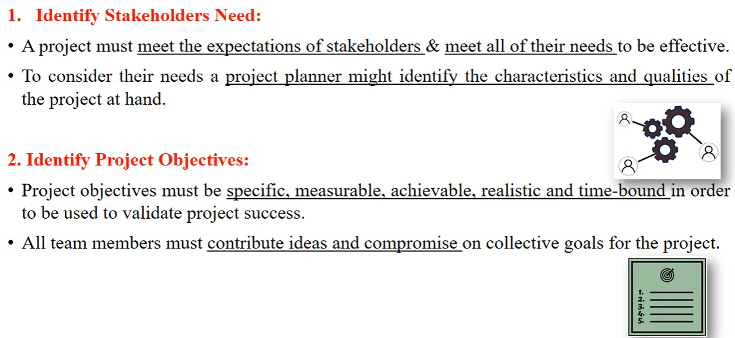
Project Planning Process

Slide 6
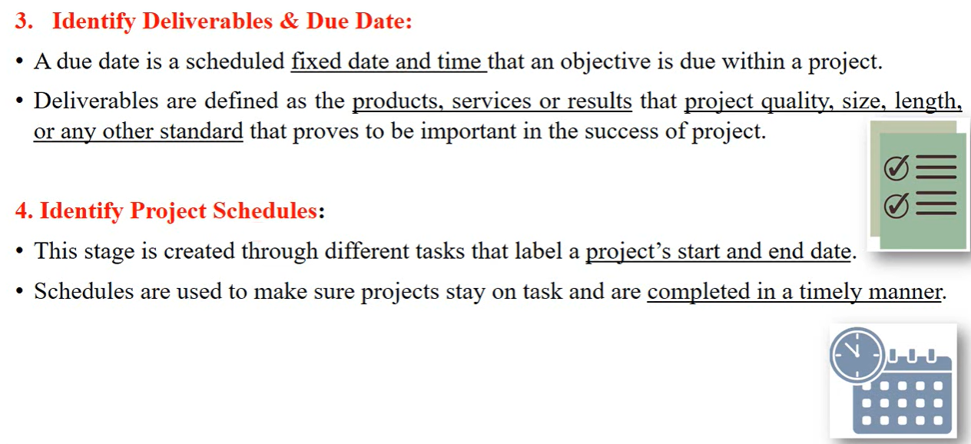
Contd…

Slide 7
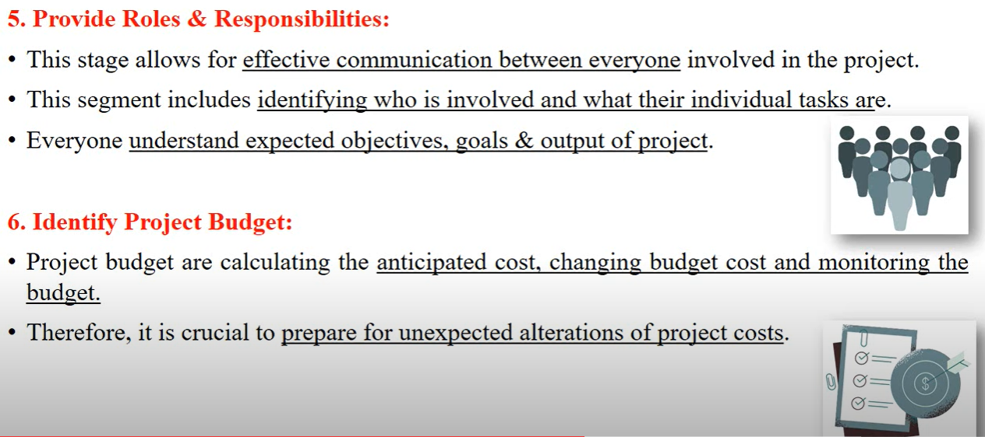
Contd…

Slide 8
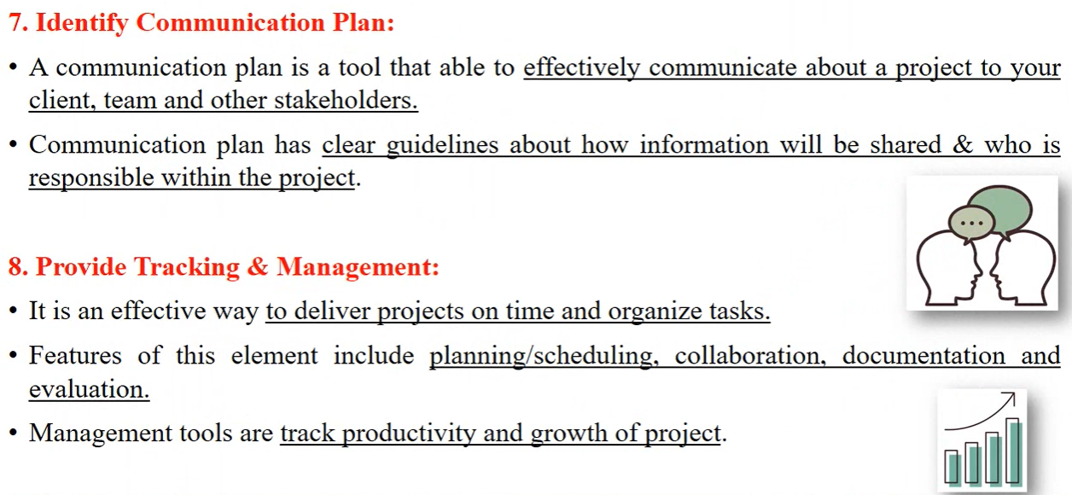
Contd…

Slide 9
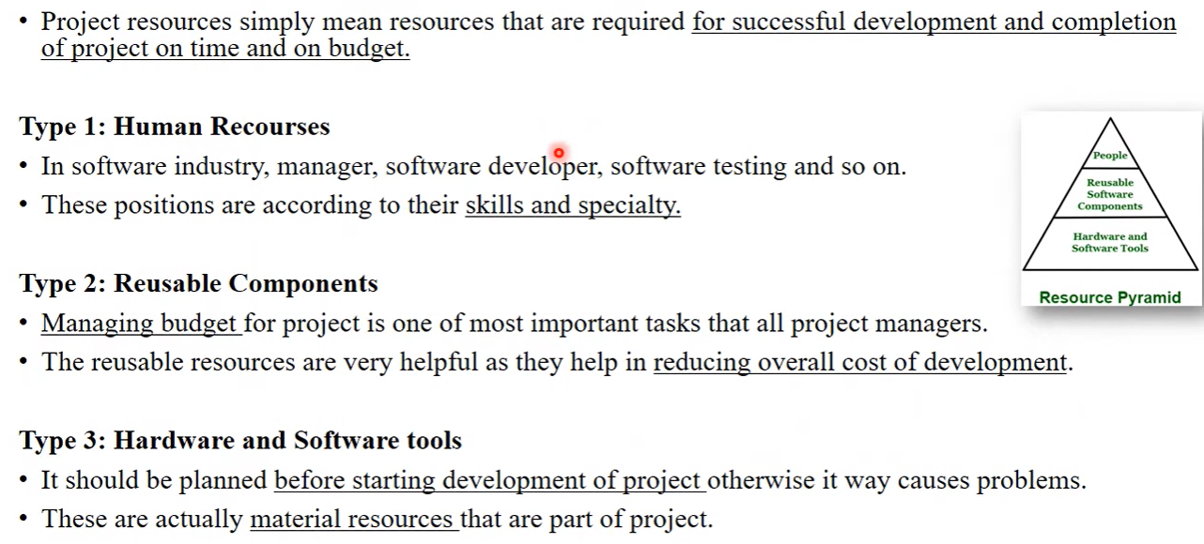
Resources used in Project Development

Slide 10
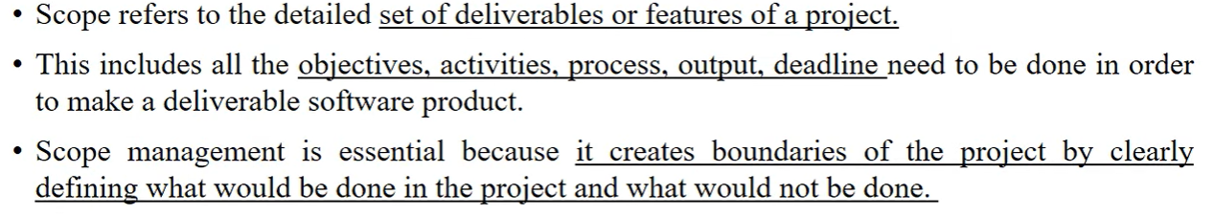
Project Scope Management

Slide 11
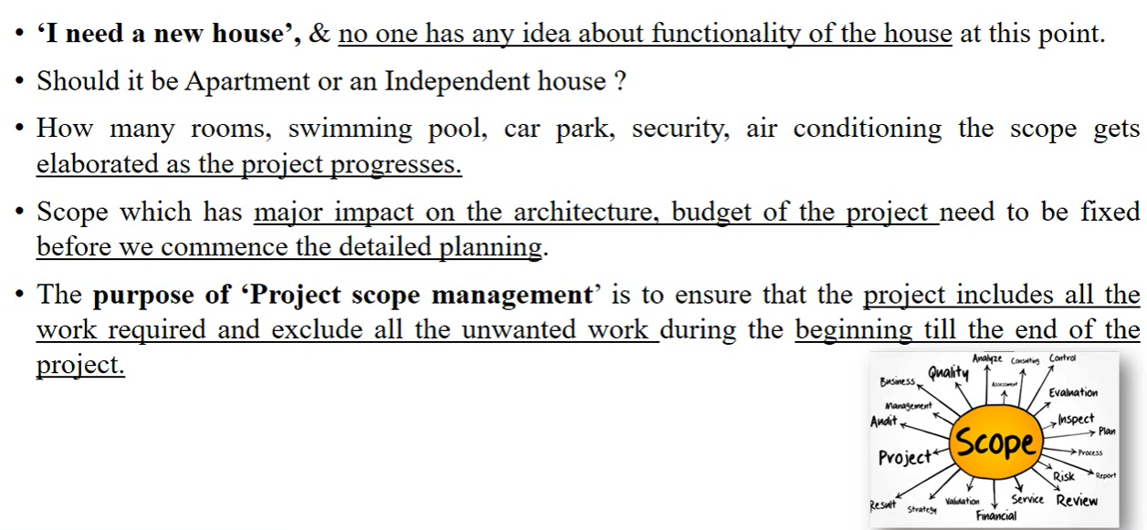
Real-Life Example

Slide 12
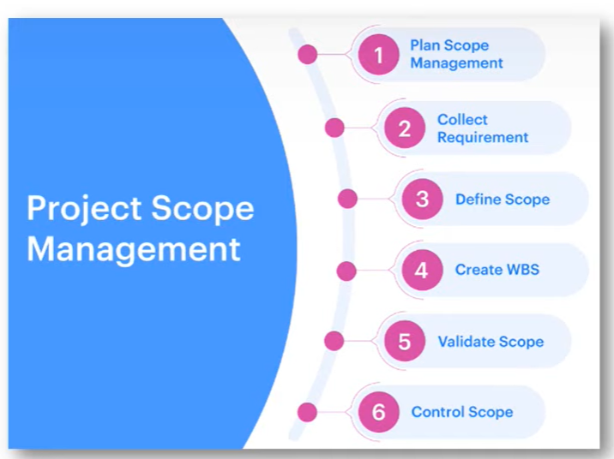
Steps of Project Scope Management

Slide 13
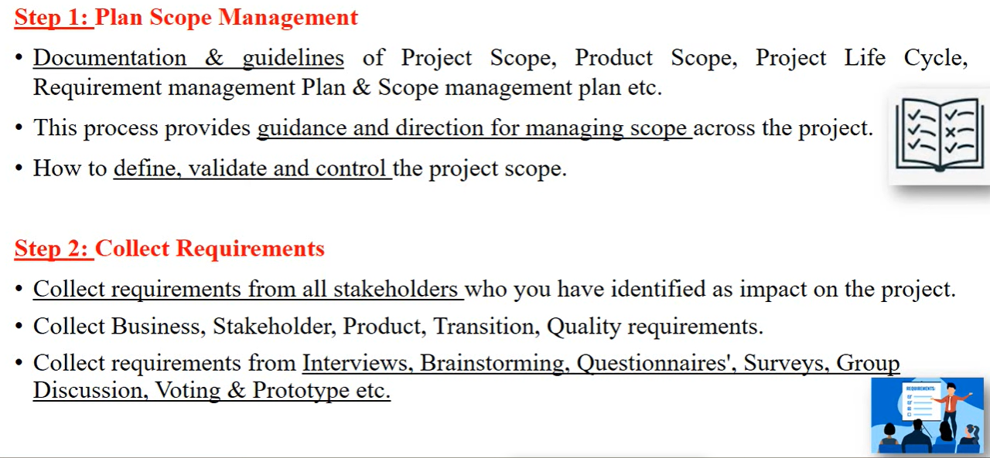
Contd…

Slide 14
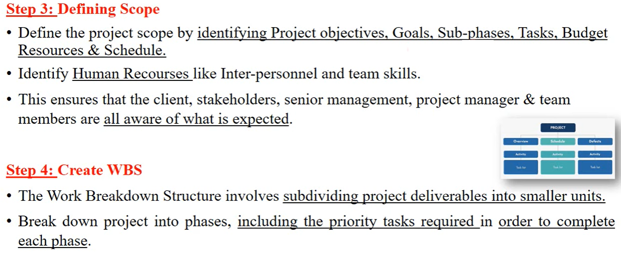
Contd…

Slide 15
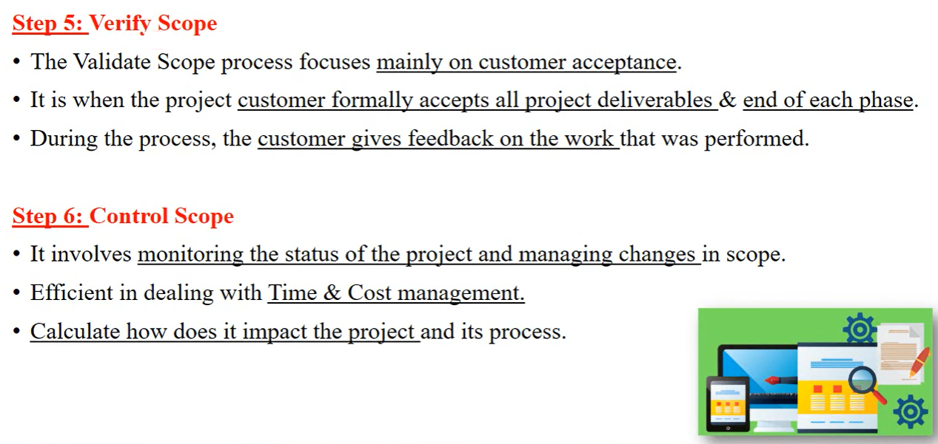
Contd…

Slide 16
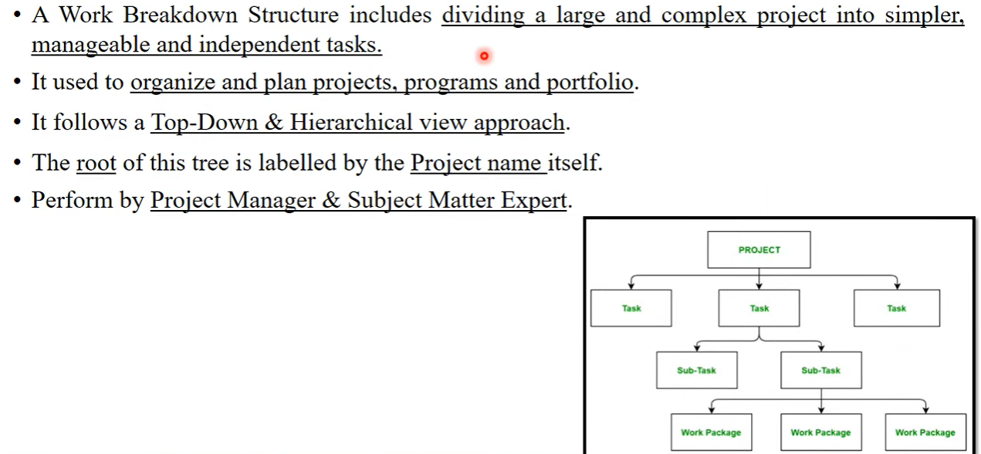
Work Breakdown Structure

Slide 17
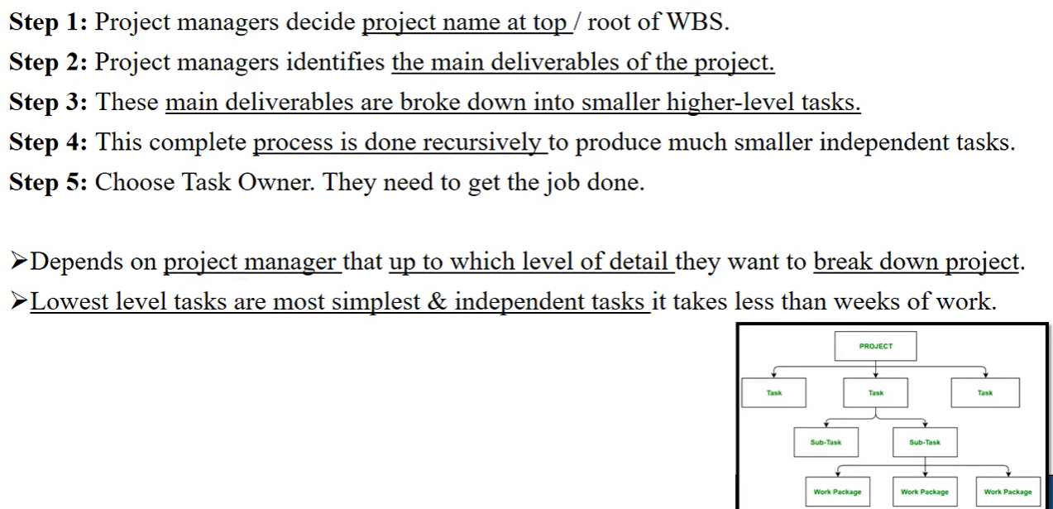
Working of WBS

Slide 18
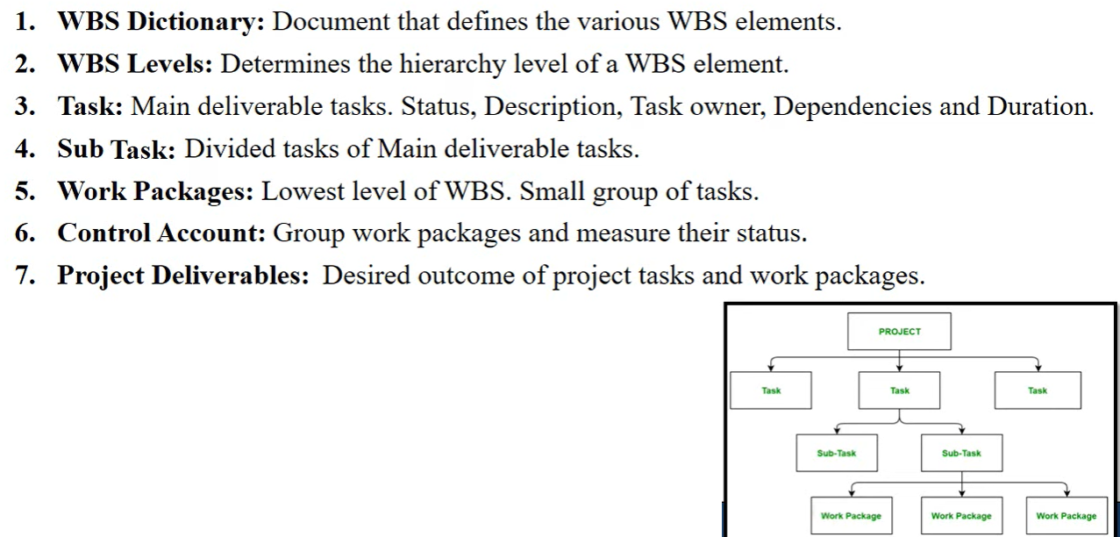
Components of WBS

Slide 19
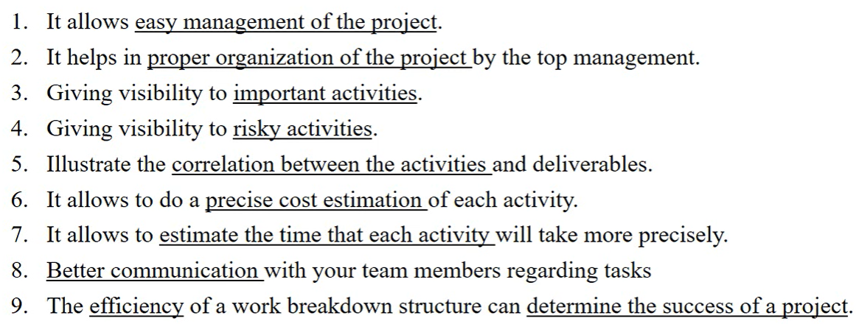
Why WBS?

Slide 20
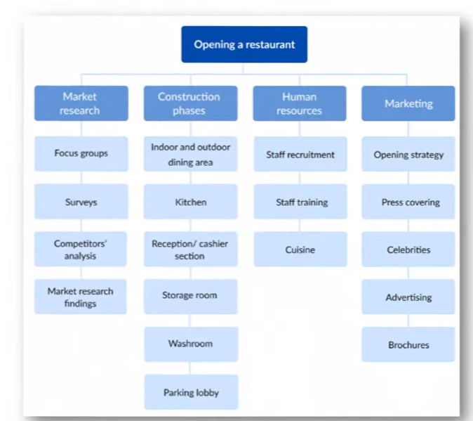
Example 1:

Slide 21
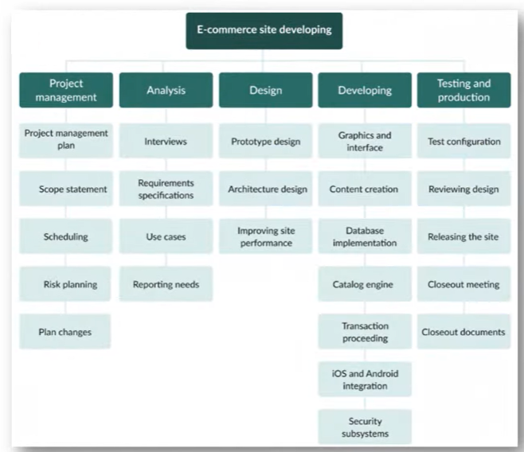
Example 2

Slide 22
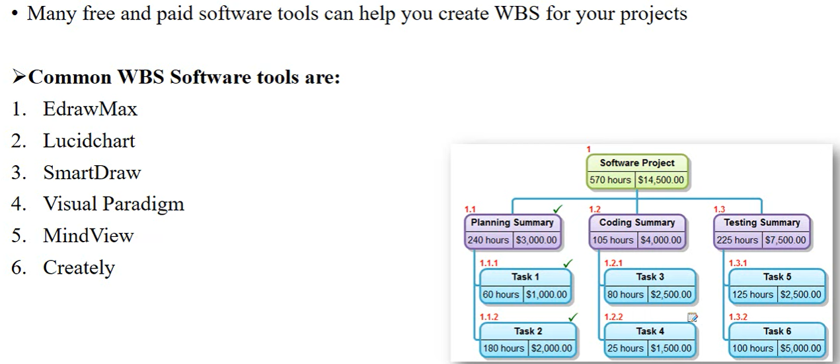
WBS Software Tools

Slide 23
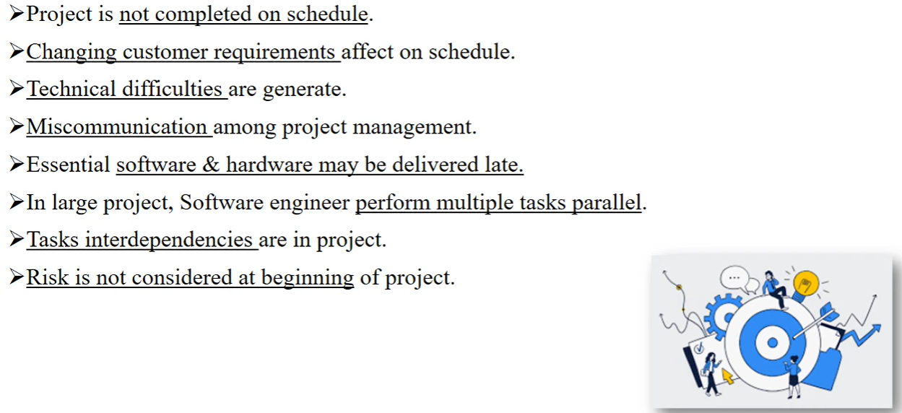
Issues in Project Management

Slide 24
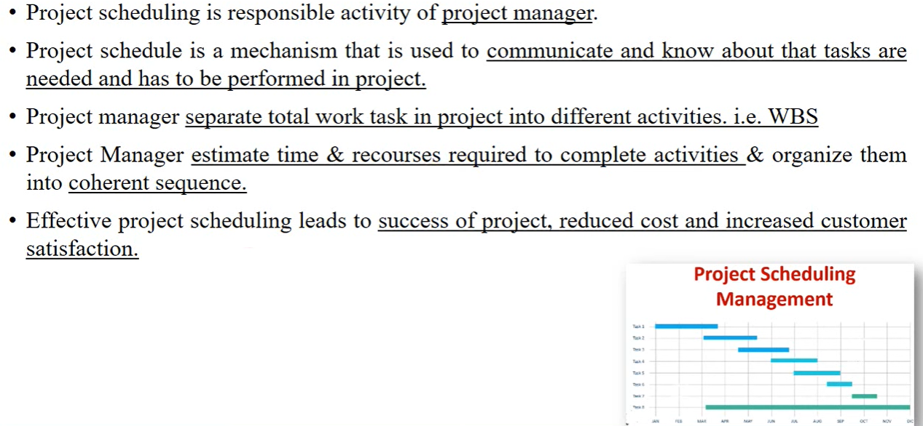
Project Scheduling

Slide 25
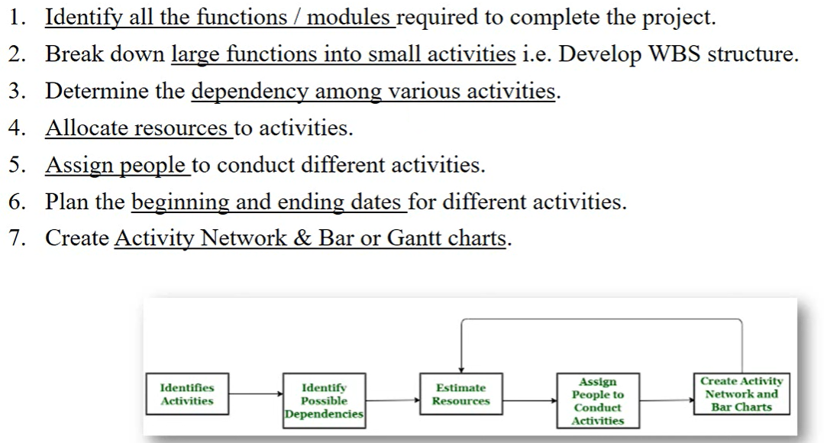
Project Scheduling Process

Slide 26
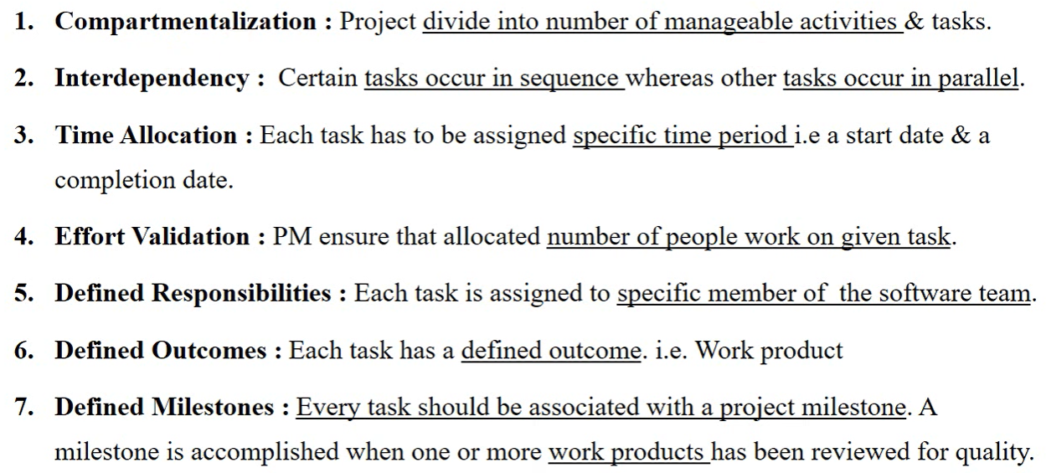
Basic Principles of Project Scheduling

Slide 27
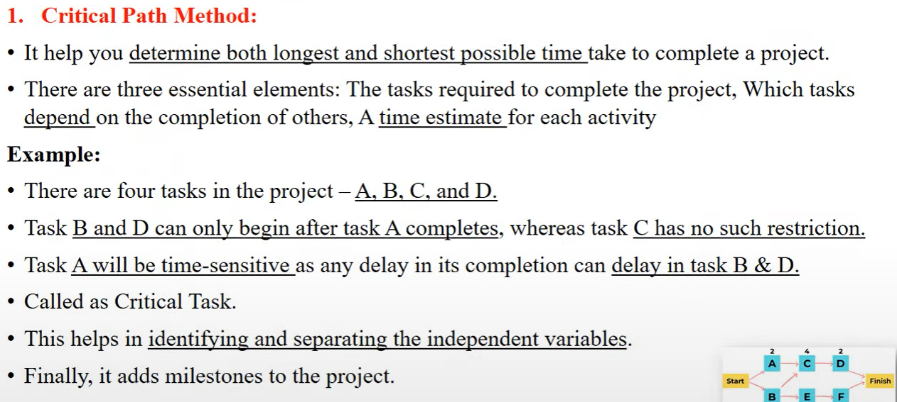
Project Scheduling Techniques

Slide 28
Self Study: Find the CPM

Slide 29
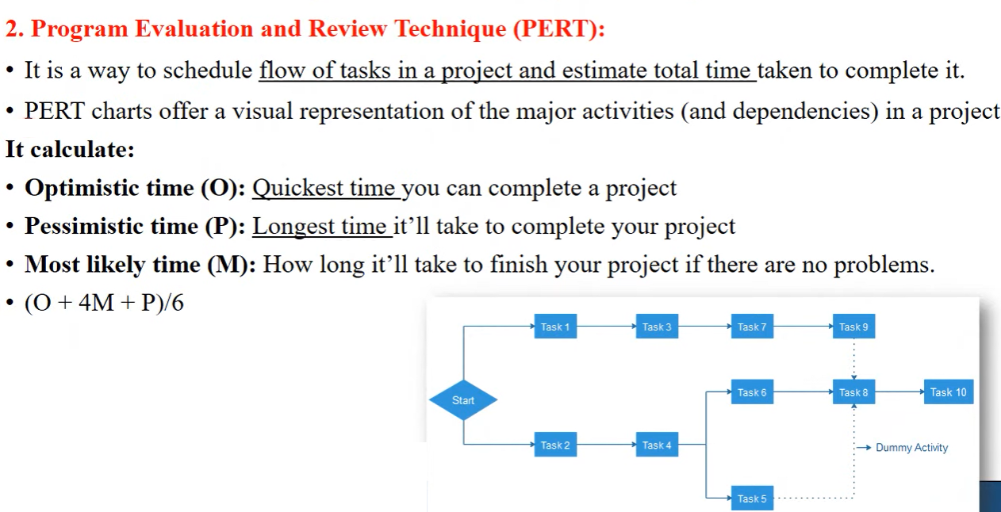
Contd…

Slide 30
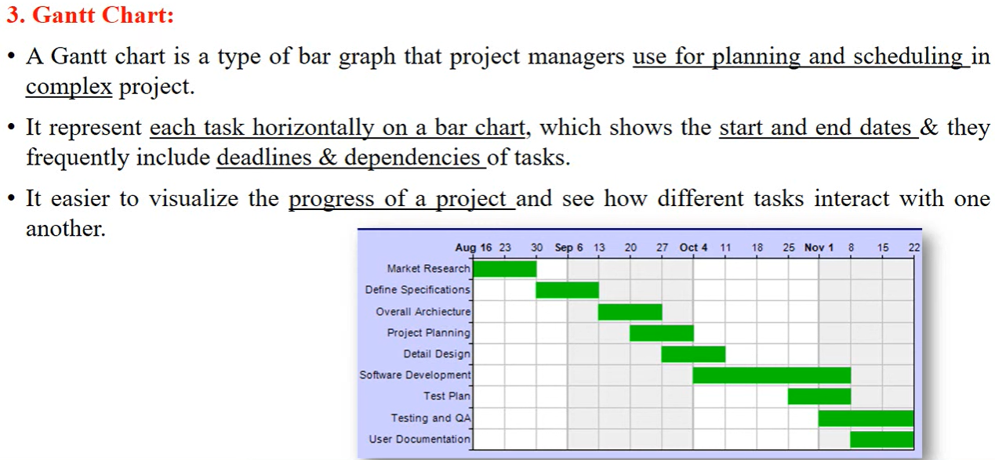
Contd…

Slide 31
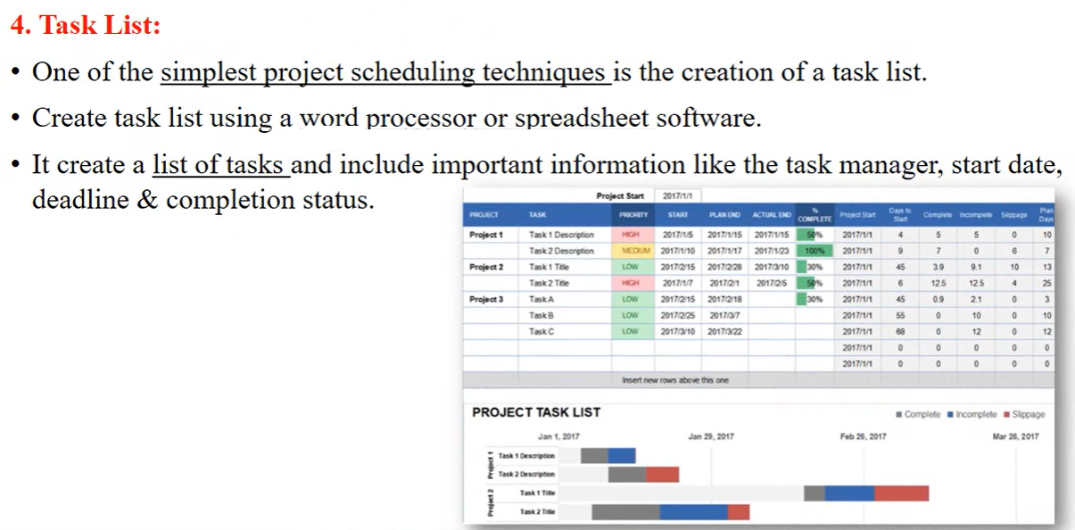
Contd…

Slide 32
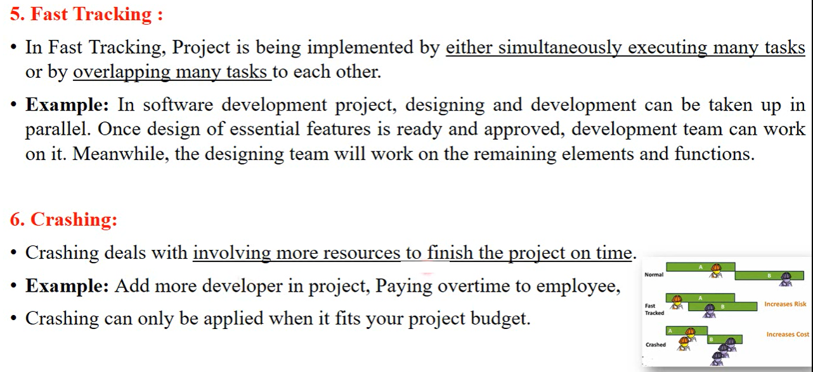
Contd…

Slide 33
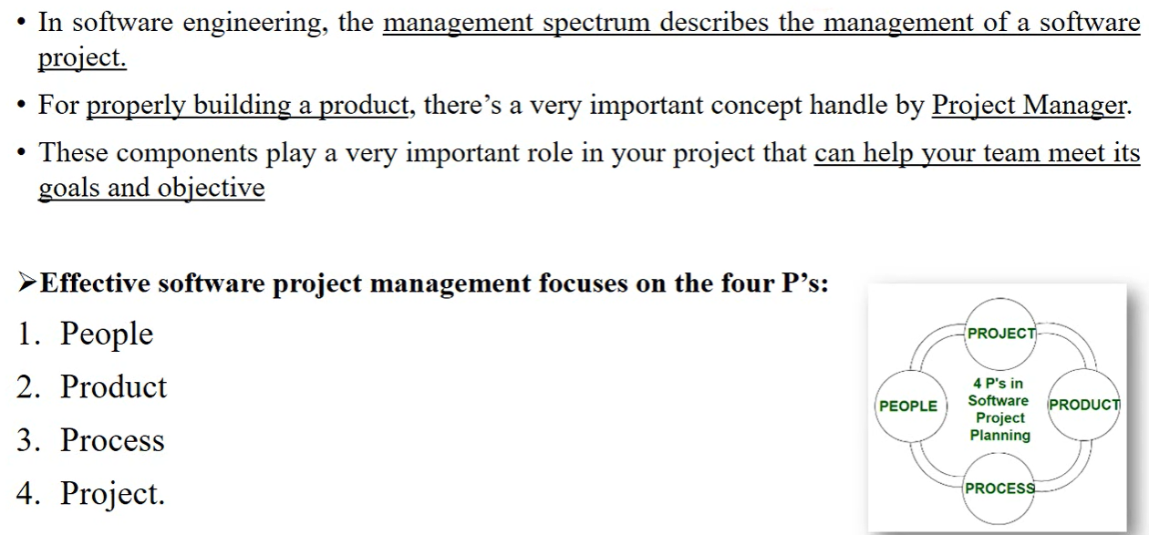
Project Management Spectrum

Slide 34
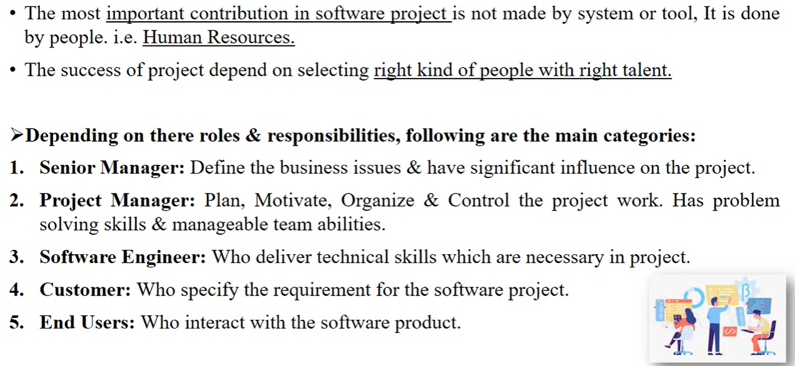
People

Slide 35
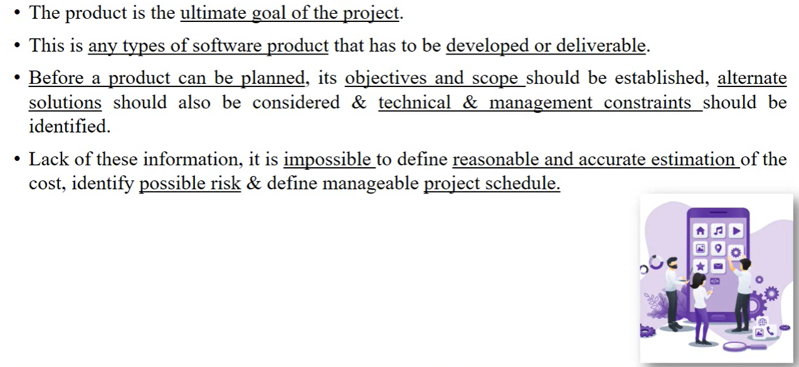
Product

Slide 36
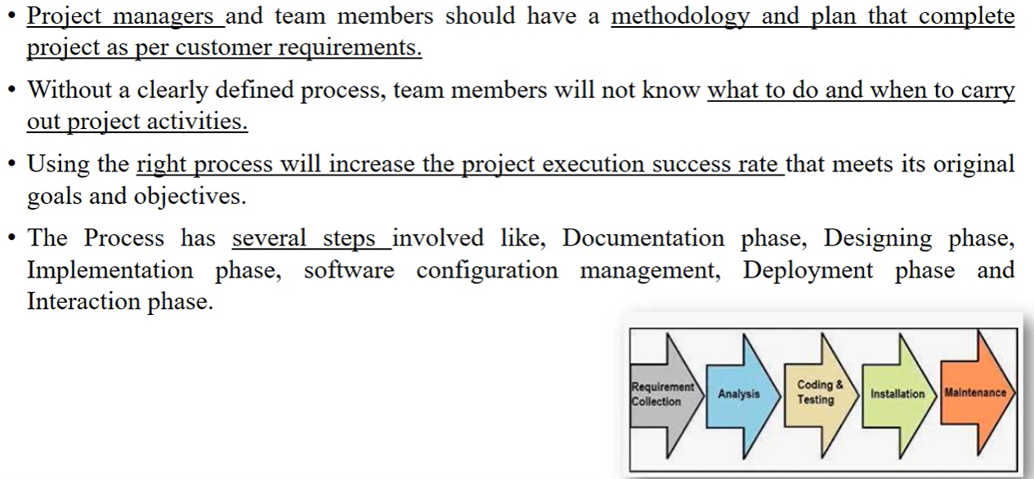
Process

Slide 37
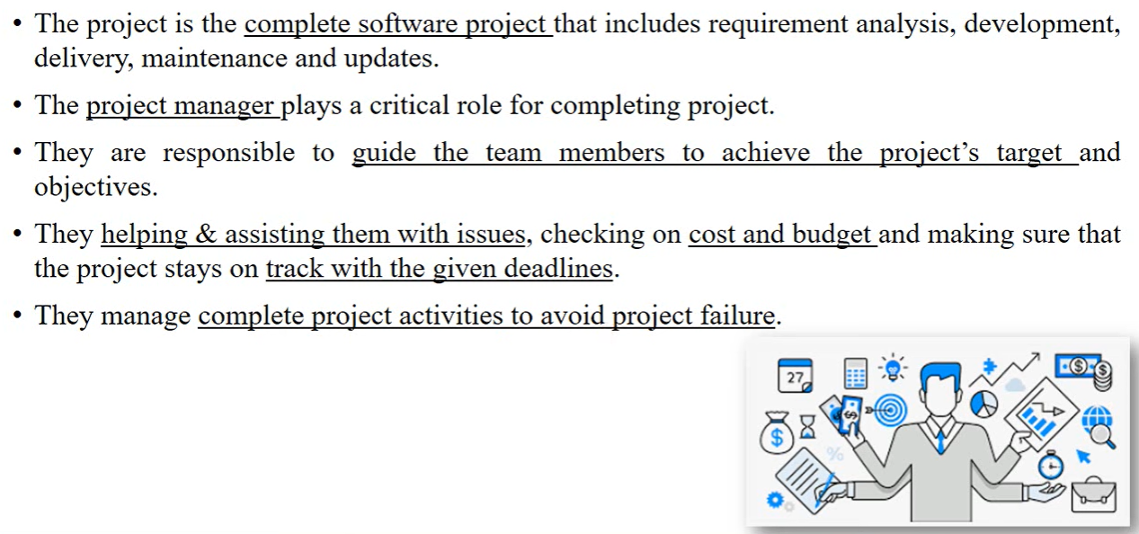
Project

Slide 38
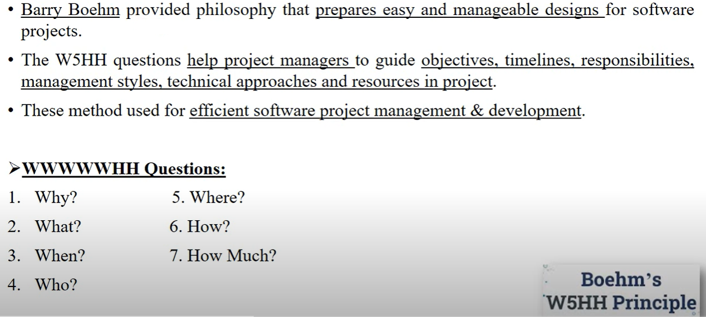
Boehm’s W5HH Principle

Slide 39
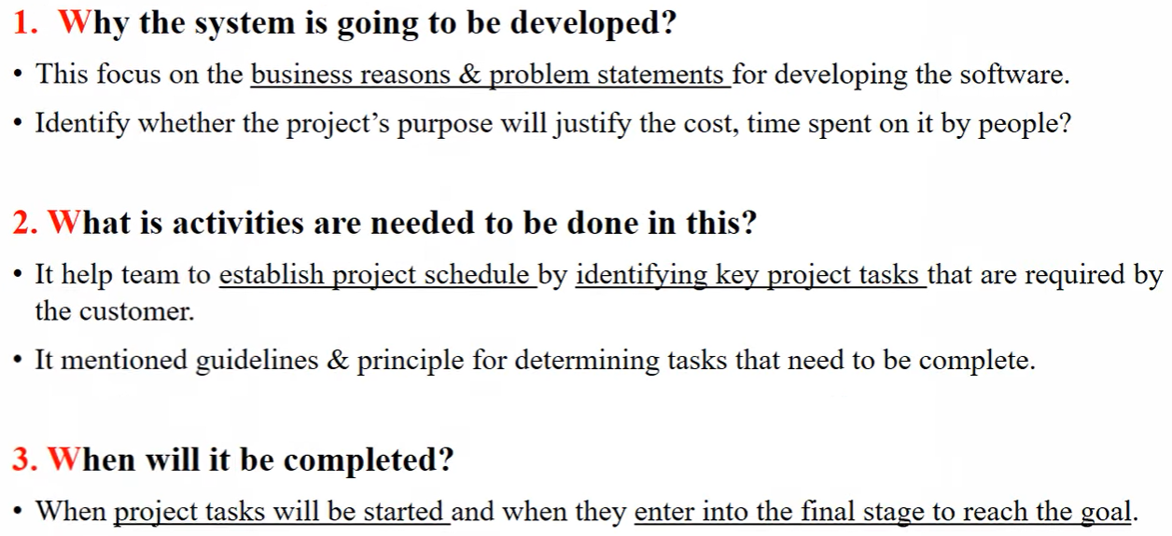
W5HH Questions

Slide 40
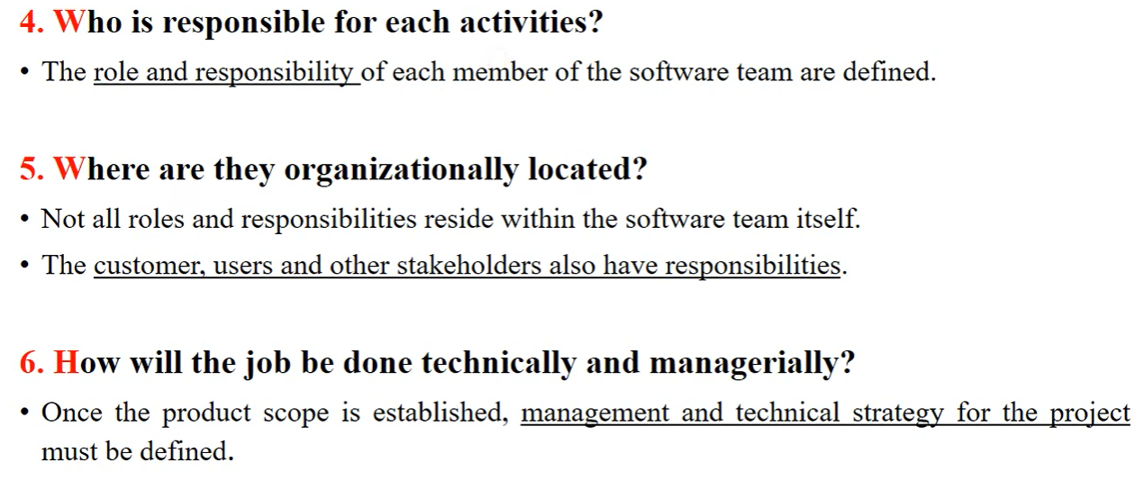
Contd…

Slide 41
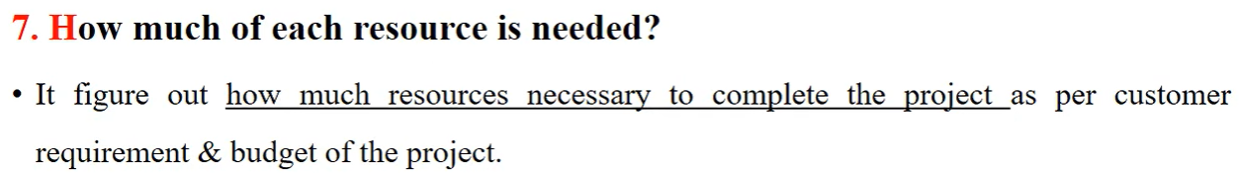
Contd…

Slide 42
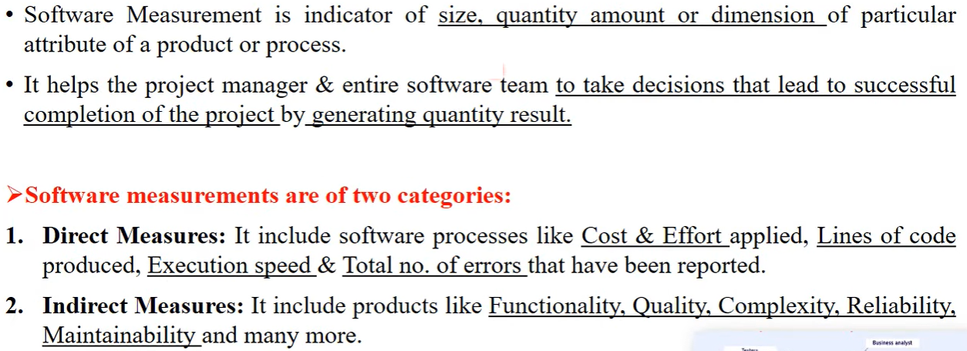
Software Measurements

Slide 43
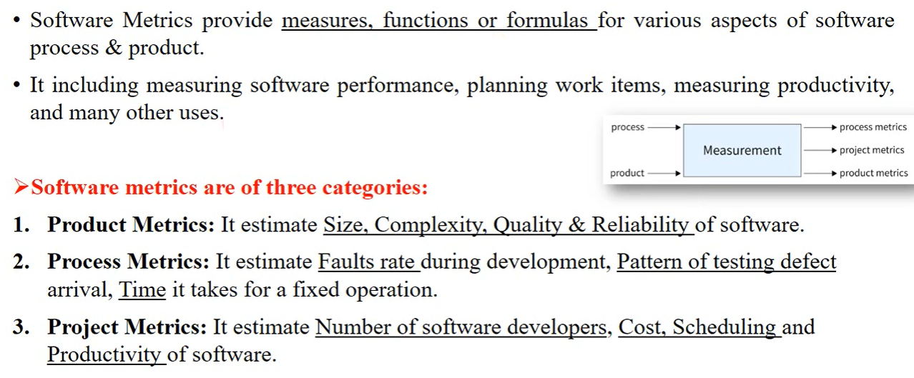
Software Metrics

Slide 44
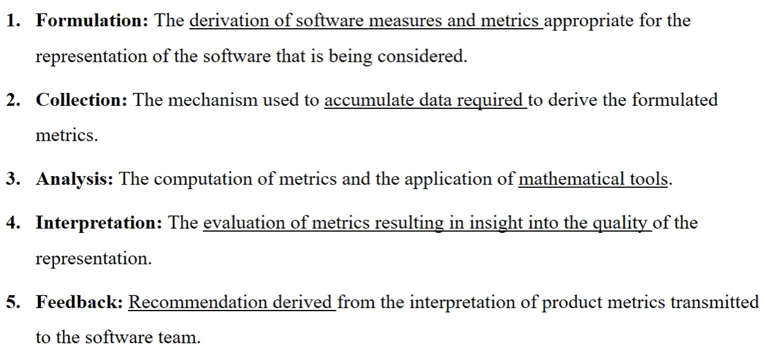
Principles of Software Measurement

Slide 45
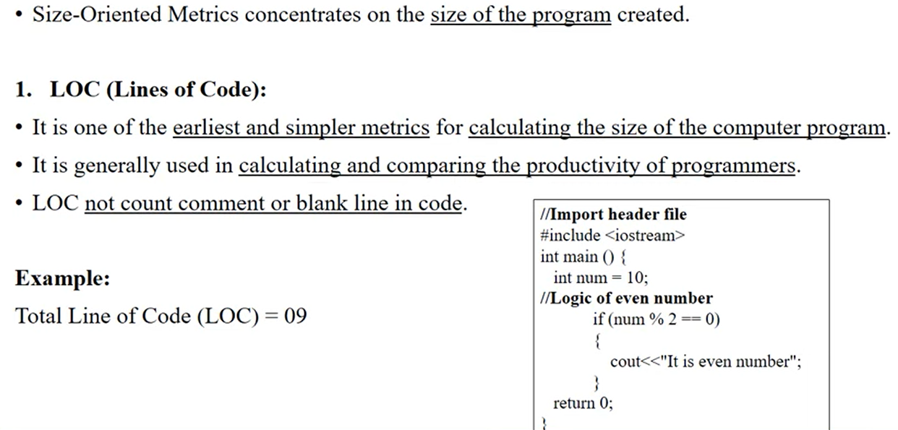
Size Metrics: LOC

Slide 46
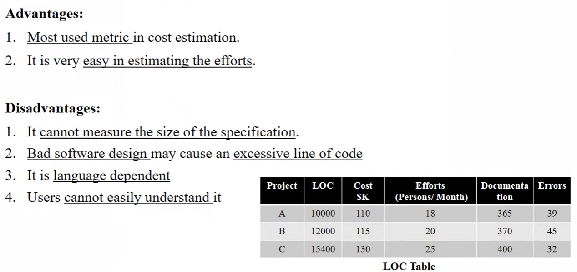
Contd…

Slide 47
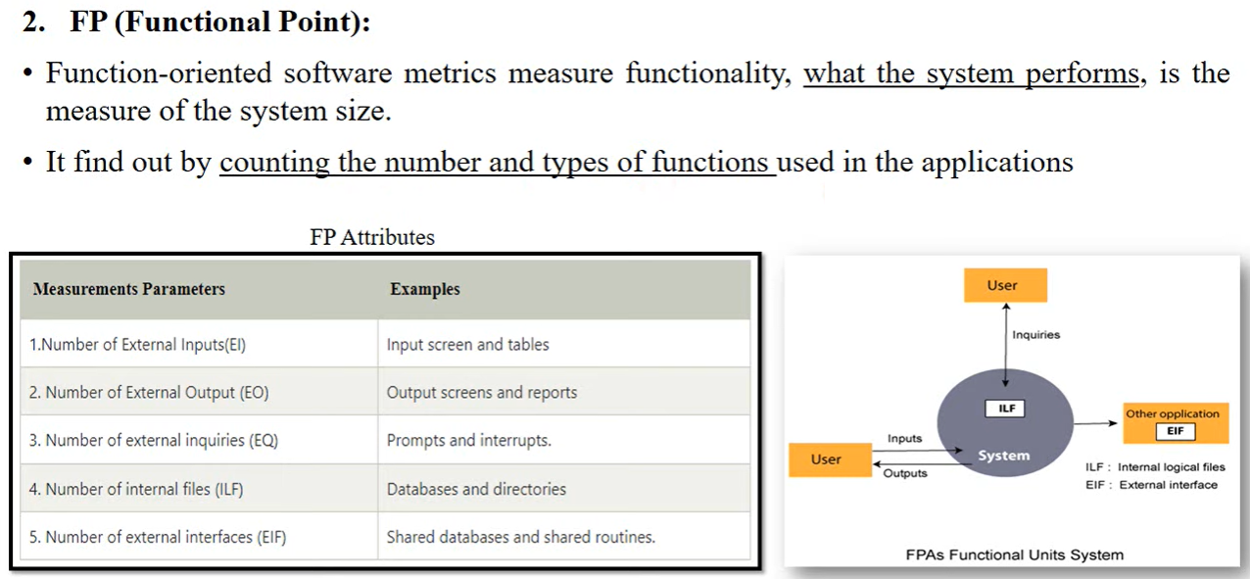
Size Metrics: FP

Slide 48
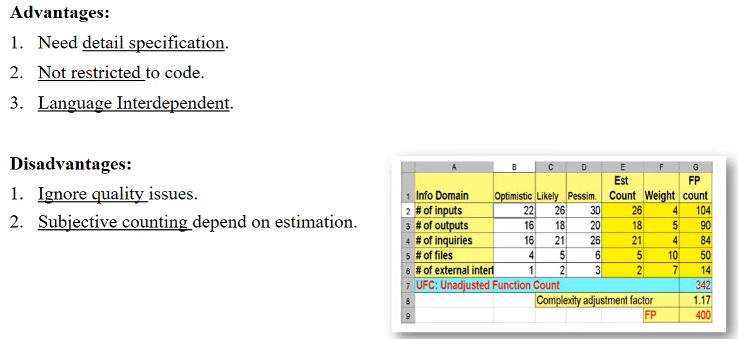
Contd…

Slide 49
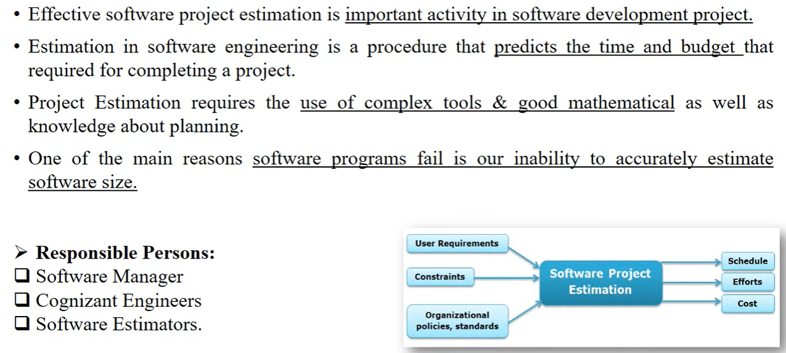
Software Project Estimation

Slide 50
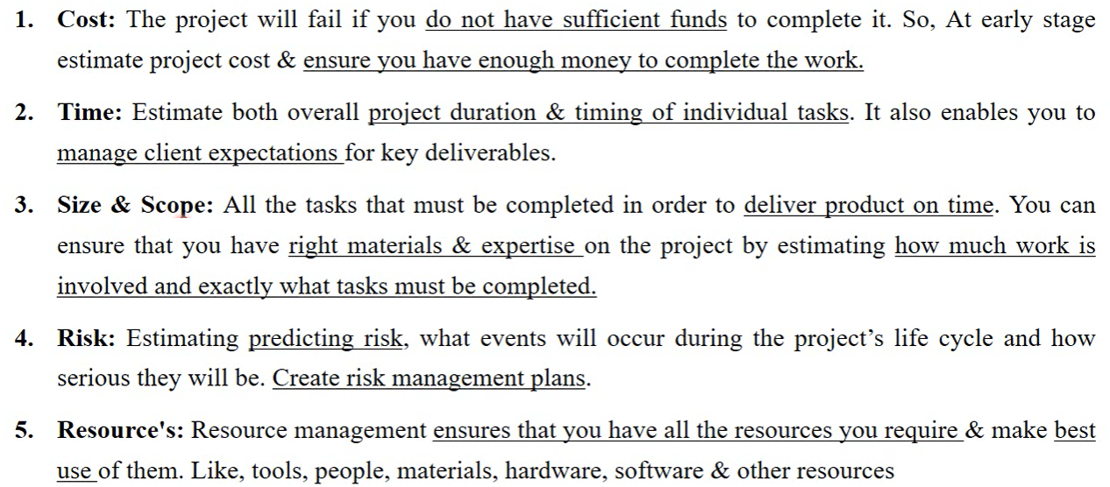
Factors affect on Project Estimation

Slide 51
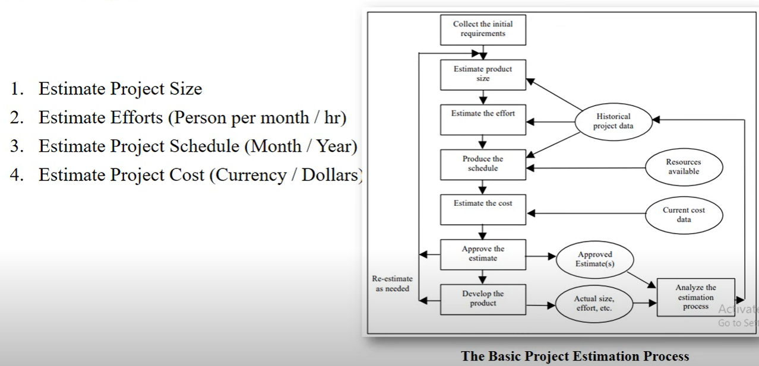
Steps of Software Project Estimation

Slide 52
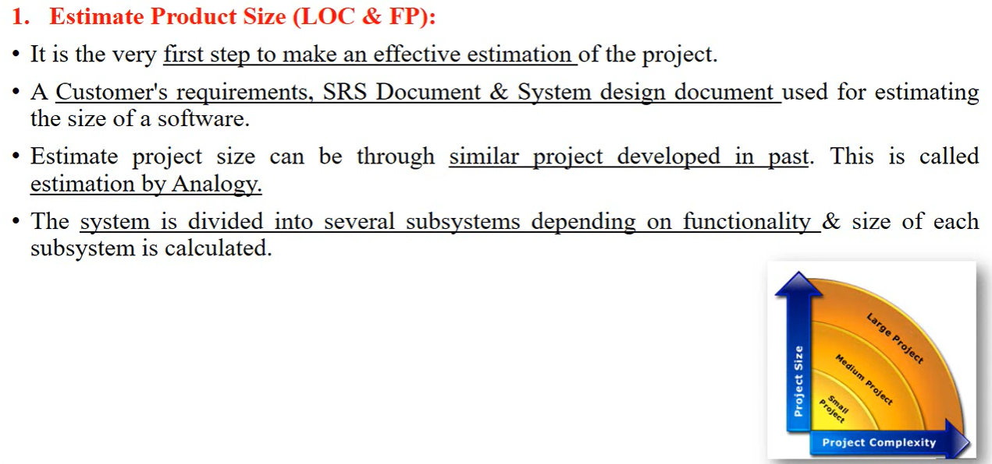
Contd…

Slide 53

Contd…

Slide 54

Contd…

Slide 55


Slide 56

Decomposition Techniques

Slide 57

Software Sizing

Slide 58

Approaches of Software Sizing

Slide 59

Contd…

Slide 60

Problem based Estimation

Slide 61

Examples of LOC and FP

Slide 62

Process based Estimation

Slide 63

Software Cost Estimation

Slide 64

Tools and Techniques of Software Cost Estimation

Slide 65

Contd…

Slide 66

Contd…

Slide 67

Contd…

Slide 68

Typical Problems with IT Cost Estimation

Slide 69

COCOMO Model

Slide 70

Software Project Types

Slide 71

Contd…

Slide 72

Types of COCOMO Model

Slide 73

Type 1: Basic COCOMO Model

Slide 74

Contd…

Slide 75

Type 2: Intermediate COCOMO Model

Slide 76

Contd…

Slide 77

Contd…

Slide 78

Type 3: Detailed/Complete COCOMO Model

Slide 79

Contd…

Slide 80

Advantages of COCOMO Model

Slide 81

Disadvantages of COCOMO Model

